Slide 1
Lecture 4
Incident Classification and Triage

Slide 2
Objectives
After studying this chapter, you should be able to:
Understand the meaning of Incident Classification and Triage
Understand Incident categorization and prioritization
Understanding Triage Analysis Process
Understand Incident response workflows and procedures
Understand Escalation processes and communication protocols
Understand Handling false positives and false negatives

Slide 3
Incident Classification and Triage
Triage helps organizations handle cybersecurity threats and system issues more effectively by using resources wisely, reducing downtime, lowering risks, improving teamwork and communication, and following rules and standards.

Slide 4
Incident Classification and Triage
Incident Classification :
Incident classification is the systematic categorization of incidents based on attributes such as severity, impact, nature, and resources affected. This process enables organizations to understand the nature of an incident and allocate appropriate resources for its resolution.
Incident Triage:
A critical incident response process that allows security teams to sort through a flood of alerts and potential threats to identify the most pressing issues. It involves immediately analyzing and prioritizing security events based on severity so that resources can be allocated accordingly. Incident Triage is a systematic method for prioritizing incidents based on their impact and urgency, thereby enabling a more effective and timely response

Slide 5
Incident Classification and Triage
The importance of triage in incident response cannot be overstated. It serves several crucial functions:
Efficient Resource Allocation: Prioritizes incidents based on urgency and impact, optimizing the use of resources.
Minimized Downtime: Swiftly addresses high-priority incidents, reducing disruption to business operations.
Risk Mitigation: Focuses on addressing threats with the greatest potential impact, preventing further escalation.
Enhanced Coordination: Establishes clear communication channels and decision-making processes among response teams.
Improved Stakeholder Communication: Enables transparent communication with stakeholders about incident severity and response timelines.
Compliance and Reporting: Helps demonstrate compliance with regulatory requirements through timely incident response and accurate reporting.

Slide 6
Incident categorization and prioritization

Slide 7
Incident categorization and prioritization
Incident categorization and prioritization can be achieved through structured methodologies and frameworks.
Incident Categorization Methodology:
Taxonomy Creation: Develop a taxonomy or classification scheme that defines categories and subcategories based on incident attributes such as nature, severity, impact, and affected resources. This taxonomy should be tailored to the specific needs and context of the organization.
Incident Identification: When an incident occurs, assess its characteristics and attributes to determine the appropriate category within the established taxonomy.
Categorization Criteria: Define clear criteria for assigning incidents to specific categories, ensuring consistency and accuracy in classification. Consider factors such as the type of incident, the systems or data affected, and the potential impact on operations.
Documentation: Document the categorization process, including the rationale behind assigning incidents to specific categories. This documentation serves as a reference for incident responders and helps maintain consistency across incidents.

Slide 8
Incident categorization and prioritization
Incident Prioritization Methodology:
Priority Criteria Definition: Define criteria for prioritizing incidents based on factors such as urgency, criticality, potential impact on operations, and regulatory requirements. These criteria should align with the organization's objectives and risk tolerance.
Scoring or Ranking: Develop a scoring or ranking system to assess incidents against the defined priority criteria. This may involve assigning numerical scores or using qualitative assessments to determine the priority level of each incident.
Thresholds or Thresholds: Establish thresholds or thresholds for each priority level to guide decision-making and resource allocation. For example, high-priority incidents may require immediate action, while lower-priority incidents can be addressed within predefined time frames.
Review and Adjustment: Regularly review and refine the prioritization methodology based on feedback, lessons learned from previous incidents, and changes in the organization's risk landscape. Continuously improving the prioritization process ensures its effectiveness in guiding incident response efforts.

Slide 9
Understanding Triage Analysis Process
When a security alert or event comes in, the triage process kicks off with some initial detection and validation steps. Analysts will look to confirm whether a real incident has taken place or if an alert is just a false positive.

Slide 10
Understanding Triage Analysis Process
Triage analysis process steps:
Detection – Validate security alert or event as a real incident vs. false positive
Scoping – Quickly investigate incident to surface attack details, affected assets, related indicators, etc.
Severity Classification – Assign severity level (low/medium/high) based on potential impact and damage
Escalation – Report the incident to appropriate parties based on the severity threshold
Containment – Initiate containment of high/critical incidents to isolate and limit damage
Queuing – Add lower severity incidents to the queue for future response based on resources
Eradication – For severe events, execute steps to eliminate threats from the environment
Recovery – For severe events, start restoration of impacted systems and data
Circle Back – Continuously analyze and Triage new security alerts as they come in

Slide 11
Understanding the Triage Analysis Process
To accomplish this objective, it’s useful to separate alerts into the following three categories:
Low-priority: Alerts that are unlikely to have any significant impact on business performance or customer satisfaction.
Medium-priority: Alerts that may have some impact on business performance or customer satisfaction, but their resolution can be delayed.
High-priority: Alerts that are likely to have a serious impact on business performance or customer satisfaction unless resolved immediately.

Slide 12
Understanding the Triage Analysis Process
So, what kind of criteria should you take into consideration when categorizing your alerts? That’s where the IT Infrastructure Library (ITIL) series of best practices for managing information systems can help.
According to ITIL, alerts can be prioritized based on the following criteria:
Impact: How severely will the business be affected.
Urgency: How long can the resolution be delayed.
An alert’s priority is the combination of its impact and urgency. The incident triage matrix below can help you correctly prioritize your alerts.

Slide 13
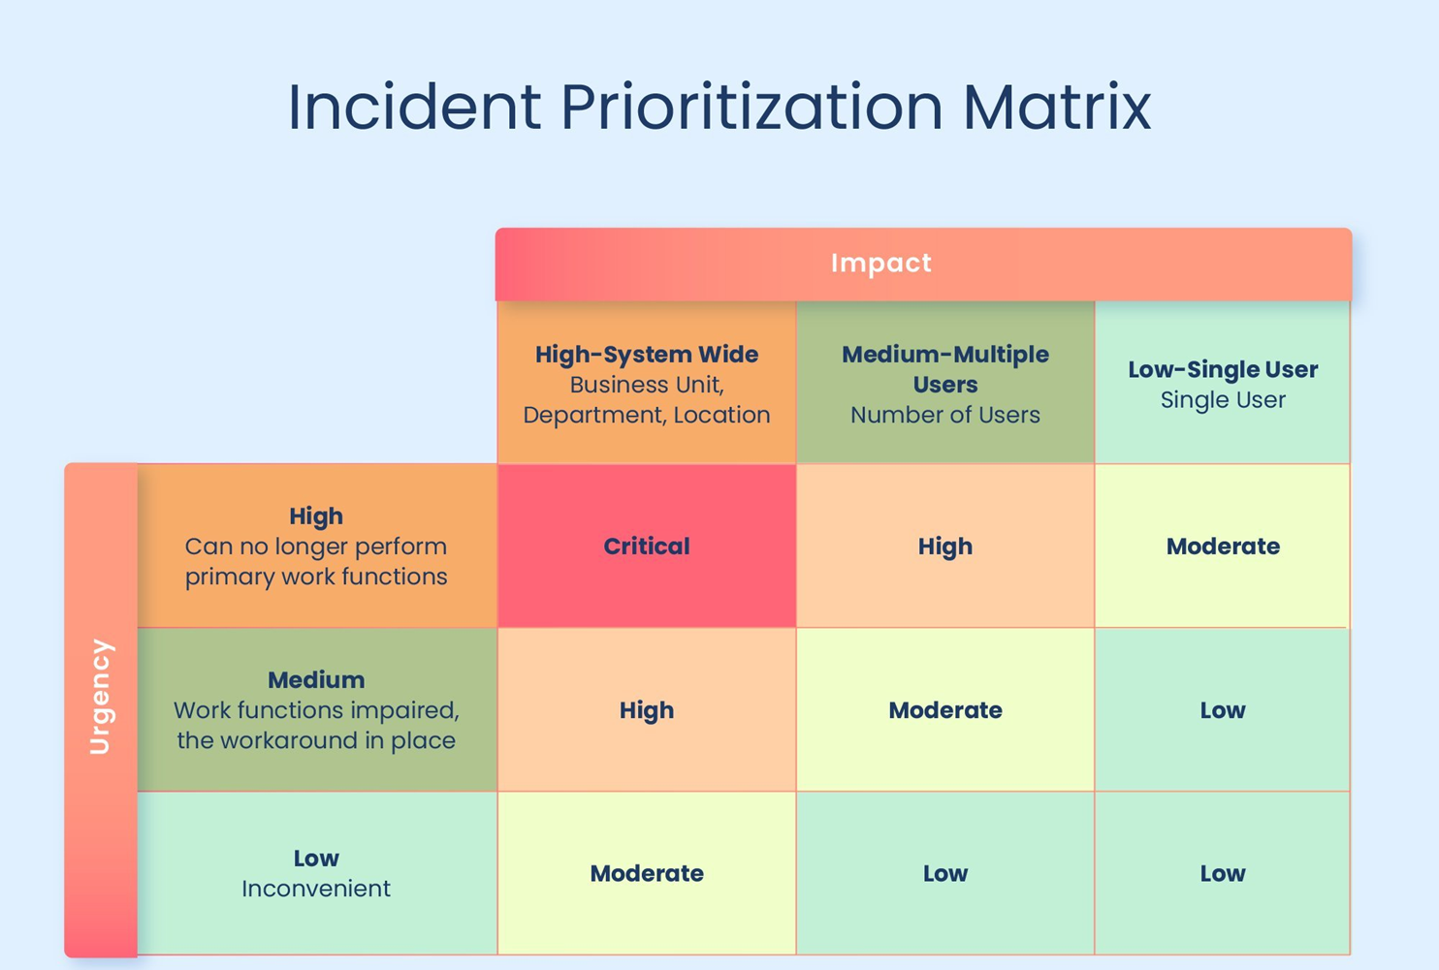

Slide 14
Examples of Triage Cybersecurity Incidents (1) (Low-Priority)
Heavy Traffic on Port 80 (Low-Priority)
Heavy Traffic on Port 80 (Low Priority)Port 80 is used for HTTP, which handles normal web browsing (unencrypted web pages).When there is heavy traffic on this port, it usually means employees are downloading or viewing a lot of web content.
Possible Cause: Normal work activity, such as accessing websites or downloading reports.
Potential Risk: Some users might visit unsafe or illegal websites that could contain malware.
Action: Monitor the traffic and check for unusual spikes, especially after business hours, to ensure there’s no suspicious activity.

Slide 15
Examples of Triage Cybersecurity Incidents (2) (Medium Priority)
Phishing Attempt (Medium Priority)
Phishing attacks make up over 80% of security incidents. They usually aren’t urgent but can still cause serious problems if someone falls for them.
Description: A phishing email tries to trick users into sharing sensitive information like passwords or clicking malicious links.
Why Medium Priority: It’s not an active attack yet, but it can lead to data theft or malware infections if ignored.
Action:
  Block the sender’s email address.
  Warn and train employees to recognize and report similar emails.
  Monitor for repeated or new phishing attempts from different addresses.

Slide 16
Examples of Triage Cybersecurity Incidents (2) (High Priority)
Ransomware Attack (High Priority)
A ransomware attack encrypts files and demands payment (ransom) to unlock them. It can spread quickly and shut down critical business operations.
Why High Priority:
Causes immediate system downtime and data loss.
Threatens business continuity and may lead to financial loss or data breaches.
Requires urgent containment to stop the spread.
Action:
Isolate the infected systems from the network immediately.
Inform the cybersecurity team and management.
Begin incident response — identify the ransomware type, restore data from backups, and remove the malware.
Report the incident if required by law or policy.

Slide 17
Incident response workflows and procedures

Slide 18
Incident response workflows and procedures
The NIST Incident Response Life Cycle is a step-by-step process created by the National Institute of Standards and Technology (NIST) to help organizations detect, respond to, and recover from cybersecurity incidents effectively. It provides a structured approach to handle security threats — minimizing damage, reducing recovery time, and improving future defences.
Preparation – Getting ready before an incident (plans, tools, training).
Detection & Analysis – Identifying and confirming that an incident has occurred.
Containment – Stopping the incident from spreading or causing more harm.
Eradication – Removing the root cause of the attack.
Recovery – Restoring systems and returning to normal operations.
Post-Incident Follow-Up (Lessons Learned) – Reviewing what happened and improving for the future.

Slide 19
Preparation, Detection & Analysis
Preparation
Meaning: Getting ready before a security incident happens.
What happens: The team creates rules, trains staff, and ensures all security tools are working.
Example: Your company sets up firewalls, updates antivirus software, and trains employees to spot phishing emails.
Detection & Analysis
Meaning: Finding out when something suspicious or wrong happens.
What happens: The team monitors systems and analyses alerts to confirm if it’s a real security issue.
Example: An employee reports a strange email asking for a password. The security team checks it and confirms it’s a phishing attempt.

Slide 20
Containment, Eradication
Containment
Meaning: Stopping the attack from spreading or causing more harm.
What happens: The affected systems are isolated or disconnected.
Example: If one computer gets infected with ransomware, the team disconnects it from the network to protect other computers.
Eradication
Meaning: Removing the cause of the attack completely.
What happens: The team deletes malware, closes security gaps, and updates systems.
Example:The IT team removes the ransomware files and installs stronger security patches or password rules.

Slide 21
Recovery,Post-Incident Follow-Up
Recovery
Meaning: Bringing systems back to normal and making sure everything is safe.
What happens: Systems are restored from backups, and the team watches for any new signs of trouble.
Example: After cleaning up the ransomware, the team restores data from backups and monitors systems for a few days to ensure the attack is gone.
Post-Incident Follow-Up
Meaning: Learning from the incident to prevent it from happening again.
What happens: The team reviews what went wrong, updates policies, and improves response plans.
Example: The company updates its phishing awareness training and adds stronger email filters based on lessons learned from the attack.

Slide 22
Escalation processes and communication protocols

Slide 23
Escalation processes
The escalation process is how an organization decides who to inform and involve when a cybersecurity incident happens — especially when it’s serious or beyond the first responder’s control.
Purpose:
To make sure the right people act quickly to fix the problem and reduce damage.
Steps (Simplified):
Identify the incident: A security analyst or monitoring system detects something unusual.
Classify the severity: Decide if it’s low, medium, or high priority.
Notify higher levels:
  Low priority: Handled by the IT/security team.
  Medium priority: Escalate to the security manager.
  High priority: Escalate to senior management, legal, and public relations teams.
Take action: The appropriate team responds based on escalation level.
Example: If a normal phishing email is detected, IT handles it.
If ransomware spreads across servers, it’s escalated to management and the incident response team immediately.

Slide 24
Communication Protocols
Communication protocols define how information is shared during a cybersecurity incident — who communicates, what they say, and how they say it.
Purpose: To ensure clear, quick, and accurate communication between all involved parties (internal teams, management, law enforcement, customers, etc.).
Key Elements:
Internal communication: Between IT staff, security teams, and management.
External communication: With partners, vendors, customers, or media (if needed).
Secure channels: Use encrypted methods like secure email or incident management tools — avoid public chat or social media.
Regular updates: Keep all stakeholders informed about progress and next steps.
Example: During a data breach, the security team reports to the incident commander, who then informs management and legal. A public statement is shared only after official approval through proper channels.

Slide 25
Importance of Escalation processes
The escalation process is crucial in cybersecurity incident response as it ensures that incidents are addressed promptly by the appropriate personnel. It enables quick decision-making, assigns clear responsibilities, and ensures effective coordination among teams.
By escalating incidents based on their severity, organizations can match the right expertise to each situation, reduce response time, and minimize business disruption. Moreover, a structured escalation process supports regulatory compliance and maintains accountability throughout the incident management process.
In summary, escalation processes help organizations respond efficiently, limit damage, and maintain operational continuity during cybersecurity incidents.

Slide 26
Handling false positives and false negatives

Slide 27
Handling False Positives and False Negatives in a SOC
In a Security Operations Centre (SOC), analysts monitor alerts generated by systems like SIEM, IDS/IPS, firewalls, antivirus, and EDR.
However, these tools sometimes generate inaccurate alerts:
False Positive (FP): Normal activity wrongly flagged as malicious.
False Negative (FN): Real threat that the system fails to detect.
Both affect SOC efficiency and overall security.

Slide 28
False Positives
A false positive occurs when an alert is triggered for legitimate activity that is not actually a threat.
Example: A security scanner (like Nessus) scans your internal servers for vulnerabilities.
The Intrusion Detection System (IDS) sees the scan traffic and raises an alert, “Possible port scanning attack.”
In reality, it’s a scheduled internal security scan, not an attack.
Impact:Analysts waste time investigating harmless activities.
Alert fatigue leads to slower response to genuine threats.
Too many false alarms reduce trust in the alerting system.

Slide 29
How to Handle:False Positives
Tune rules and thresholds – Adjust IDS/SIEM rules to reduce unnecessary alerts.
Whitelist known safe sources – Add internal scanners or management systems to a trusted list.
Use context-based correlation – Combine multiple signals (e.g., user identity, time, and network location) before raising alerts.
Implement feedback loops – Analysts mark false positives to help improve detection rules.
Automate repetitive checks – Use SOAR tools to suppress repeated benign alerts automatically.

Slide 30
False Negatives
A false negative occurs when a real malicious activity happens but no alert is generated the system misses it.
Example:
A user opens an email attachment containing a new type of ransomware that isn’t yet known to antivirus signatures.
The antivirus fails to detect it because the malware uses new, obfuscated code.
The ransomware encrypts files before any alert is triggered this is a false negative.
Impact:
Undetected attacks can spread within the network.
Leads to data breaches or system compromise.
Delays incident response and damages organizational reputation.

Slide 31
How to Handle: False Negatives
Threat Hunting: Proactively search logs and network data for suspicious patterns that might have been missed.
Update threat intelligence: Regularly refresh signatures and indicators of compromise (IOCs).
Behavioral analytics: Use UEBA (User and Entity Behavior Analytics) to detect unusual behavior instead of relying only on known signatures.
Red Team exercises: Simulate attacks to identify what current tools fail to detect.
Machine learning models: Continuously train detection systems with new data.

Slide 32
Balancing Sensitivity: SOC teams must balance
Too sensitive → Too many false positives.
Too relaxed → Too many false negatives.
Example:
If your SIEM flags every login attempt as “suspicious,” you’ll drown in false positives.
If it only flags after 10 failed logins, a real brute-force attack might be missed.
The goal is to find a sweet spot: detect real threats early while minimizing noise.

Slide 33
Continuous Improvement Cycle
SOC teams should follow a feedback loop:
Detect → 2. Validate → 3. Tune rules → 4. Test → 5. Improve
Example:
After a week of analysis, the SOC team notices 30% of IDS alerts are false positives from vulnerability scans.
They tune detection rules → false positives drop → real threat visibility improves

Slide 34
References
National Institute of Standards and Technology (NIST). (2012). Computer Security Incident Handling Guide (Special Publication 800-61 Revision 2). U.S. Department of Commerce. https://doi.org/10.6028/NIST.SP.800-61r2
International Organization for Standardization. (2013). ISO/IEC 27035-1:2013 – Information technology — Security techniques — Information security incident management — Part 1: Principles of incident management. ISO.
ENISA (European Union Agency for Cybersecurity). (2021). Guidelines for incident response and management. Retrieved from https://www.enisa.europa.eu/
SANS Institute. (2020). Incident Handler’s Handbook. Retrieved from https://www.sans.org/white-papers/
Whitman, M. E., & Mattord, H. J. (2022). Principles of Information Security (7th ed.). Cengage Learning.
ITIL Incident Management Priority Matrix. (n.d.). Retrieved from https://buildahelpdesk.com/itil-incident-management-priority-matrix
Lockheed Martin. (2022). Cyber Kill Chain. Retrieved from https://www.lockheedmartin.com/en-us/capabilities/cyber/cyber-kill-chain.html
AT&T Cybersecurity. (n.d.). Categorize Information Security Incident Types by Getting Inside the Mind of the Attacker. Retrieved from https://cybersecurity.att.com/resource-center/ebook/insider-guide-to-incident-response/types-of-security-incidents
CCS Learning Academy. (2023). Cyber Security Triage: Learn the Essentials. Retrieved from https://ccslearningacademy.com
Jarpey, G., & McCoy, R. S. (2021). Security Operations Center Guidebook: A Practical Guide for a Successful SOC (Chapters 5–6). CCS Learning Academy. Retrieved from https://www.ccslearningacademy.com/what-is-triage-in-cyber-security/

